Slide 1



Team “Transformers”
Android course teamwork assignment:
“Hotel Catalog”
Team members:
Чавдар Цветков - Radvach
Георги Янакиев – m3tr0n0m3

Slide 2
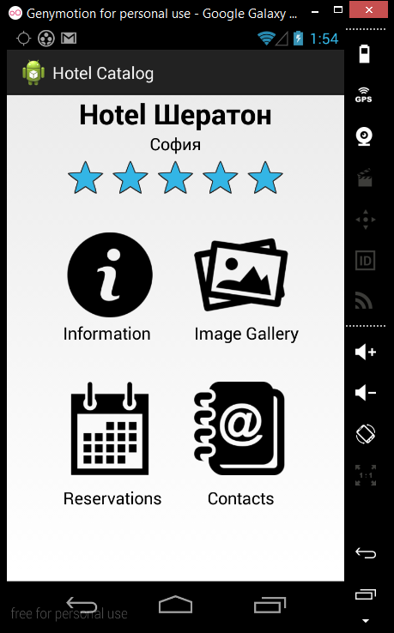
Project Purpose
The purpose of the project is to build a mobile application to provide brief information for hotels, as well as image galleries, option to make reservations and hotel’s contact information.

Slide 3



Design and Implementation
Github : https://github.com/Team-Transformers/AndroidMobileApp

Slide 4
Live Demo

Slide 5


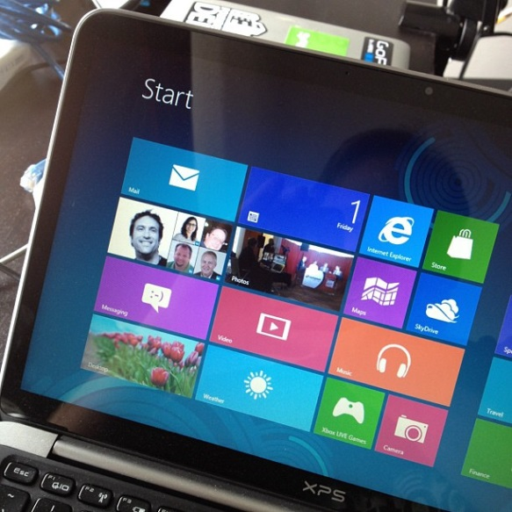

Questions ?
?
?
?
?

